Slide 1
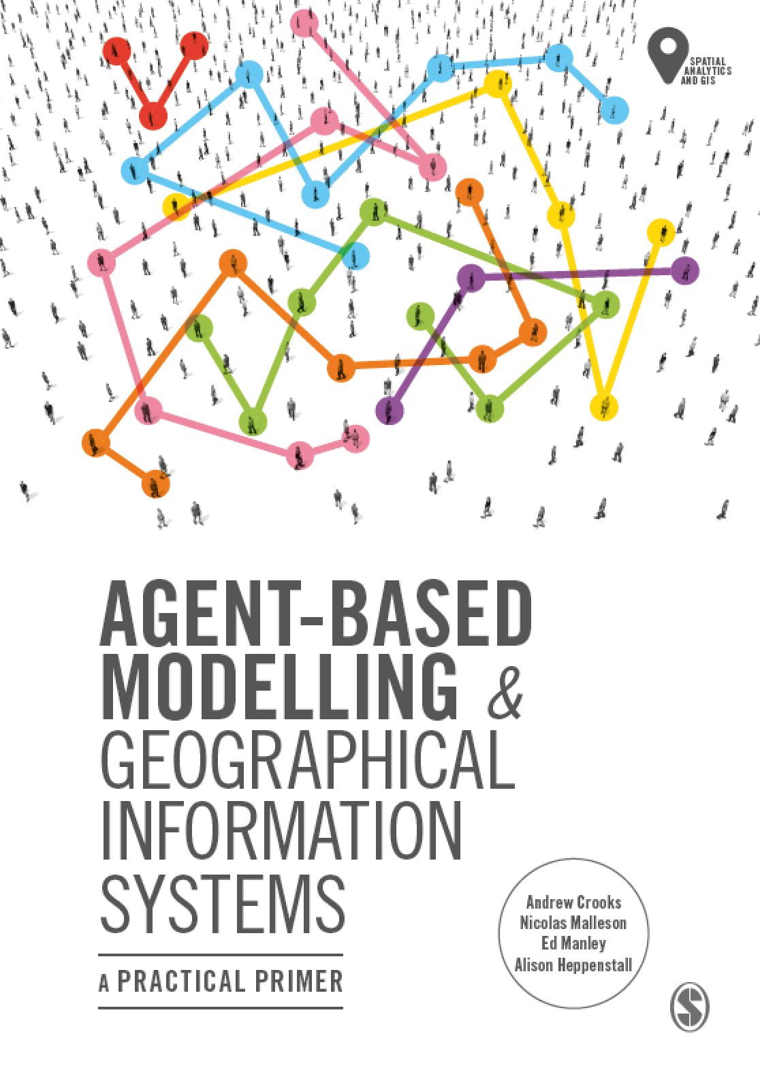
Chapter 8
Networks
Notes:
Networks play a critical role in our lives in terms of physical networks we use to navigate upon, our social networks and more recently how we communicate via cyber networks (e.g. social media). This chapter provides a brief introduction to such networks and shows how they can be integrated into agent-based models. Importantly, a model is also introduced that demonstrates how to navigate agents along a physical road network (this is a common requirement for spatially-explicit agent-based models). The chapter concludes with a discussion about how networks can be combined to study real world phenomena and highlight future areas of research.

Slide 2
Learning Objectives
By the end of this chapter, students will be able to:
Understand the main properties of a network
Understand different network structures
How networks can be combined to study real-world phenomena.
How networks can be leveraged within agent-based models.
Notes:
Networks play a critical role in our lives. Our movements are constrained to
physical networks (e.g. roads), our social networks determine the people we
are likely to interact with, and more recently cyber networks (e.g. social media
services and mobile telephone networks) constrain our communications. This
chapter provides a brief introduction to such networks and shows how they
can be integrated into agent-based models. A model is introduced that demonstrates
how to navigate agents along a physical road network (this is a common
requirement for spatially explicit agent-based models).

Slide 3
Introduction
Networks are everywhere and play an important role in driving the processes and dynamics within social and geographical systems.
For example, cites are the result of potentially finite numbers of networks involving the movement of goods, money, people, etc. (batty, 2013)
With respect to agent-based models, networks provide us with a means to study the connections between people and places.
Notes:
Networks play a critical role in our lives. Our movements are constrained to
physical networks (e.g. roads), our social networks determine the people we
are likely to interact with, and more recently cyber networks (e.g. social media
services and mobile telephone networks) constrain our communications. This
chapter provides a brief introduction to such networks and shows how they
can be integrated into agent-based models. A model is introduced that demonstrates
how to navigate agents along a physical road network (this is a common
requirement for spatially explicit agent-based models).

Slide 4
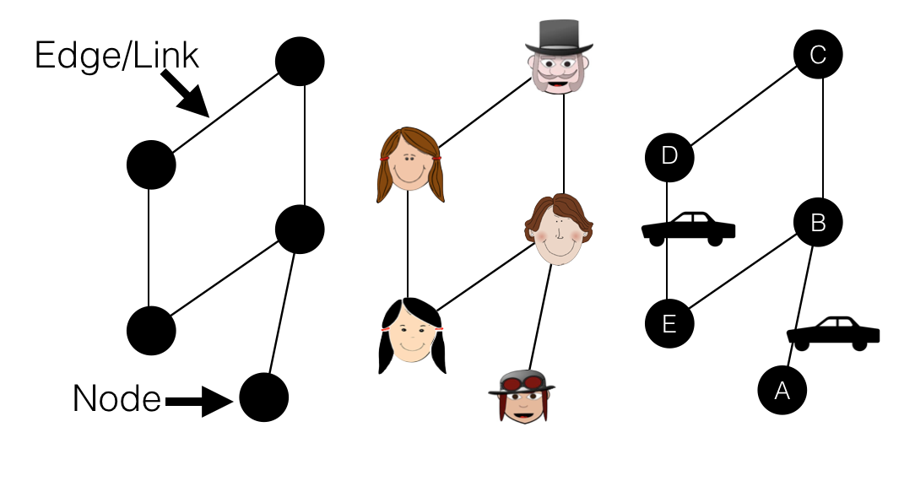
Graphs and Networks
Figure 8.1: From left to right, a basic graph, a social network and a simplified transportation network.

Slide 5
Basic Network Properties
Notes:
Left blank

Slide 6
Defining Graphs Mathematically
By abstracting a network to a graph we can explore mathematically the connections between people and/or places.
A graph (G) is composed of nodes/vertices (V) and edges (E).
Edges are a subset of V × V.
If E = V × V the graph is complete (i.e. there are the same number of edges as nodes).
Often the terms network and graph are used interchangeably,
The term ‘network’ often refers to a real system
E.g., World Wide Web or a social network)
The term ‘graph’ often refers to the mathematical representation of a network
E.g., links between web pages in web graphs.

Slide 7
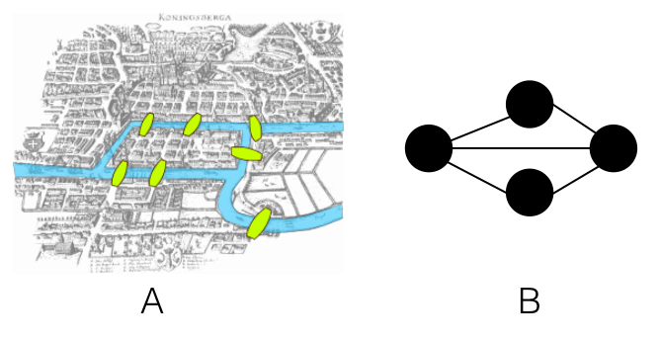
The Seven Bridges of Konigsberg problem
Euler abstracted the seven real-world Königsberg bridges (A) as a graph, whereby the land (the two banks of the river and the islands) are represented as nodes and the bridges as links
Figure 8.2: The Seven Bridges of Konigsberg problem. A: the physical depiction of the bridges (Source: Giusca, 2017) and B: the graph representation

Slide 8
Building Graphs in NetLogo
What is particularly appealing about graphs is that the links between nodes can have different properties.
For example, the links can be undirected, such that objects or information can flow in both directions:
Counties that share a common border, or actor A was in a movie with actor B).
Alternatively, they can be directed:
Cars can only drive one way down a road, or a professor who lectures to students).
By understanding the connections (ties) within a graph we can thus explore the nature of the relationships.

Slide 9
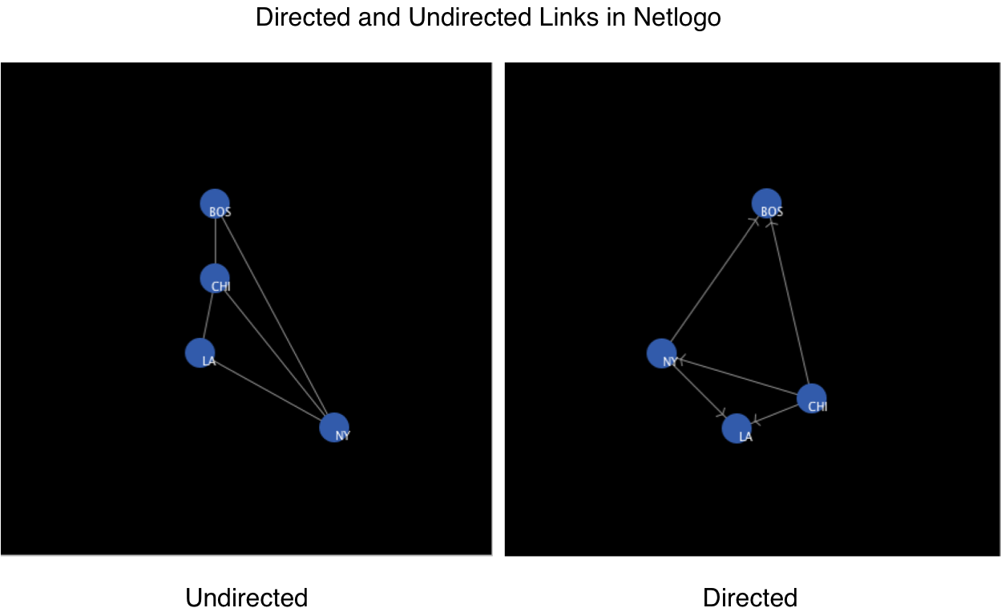
Directed and Undirected Links in NetLogo
Figure 8.3: Directed and undirected links as displayed in NetLogo. These examples are from the ‘Undirected Network Demo’ and ‘Directed Network Demo’ at: https://github.com/abmgis/abmgis/tree/master/Chapter08-Networks/Models.

Slide 10
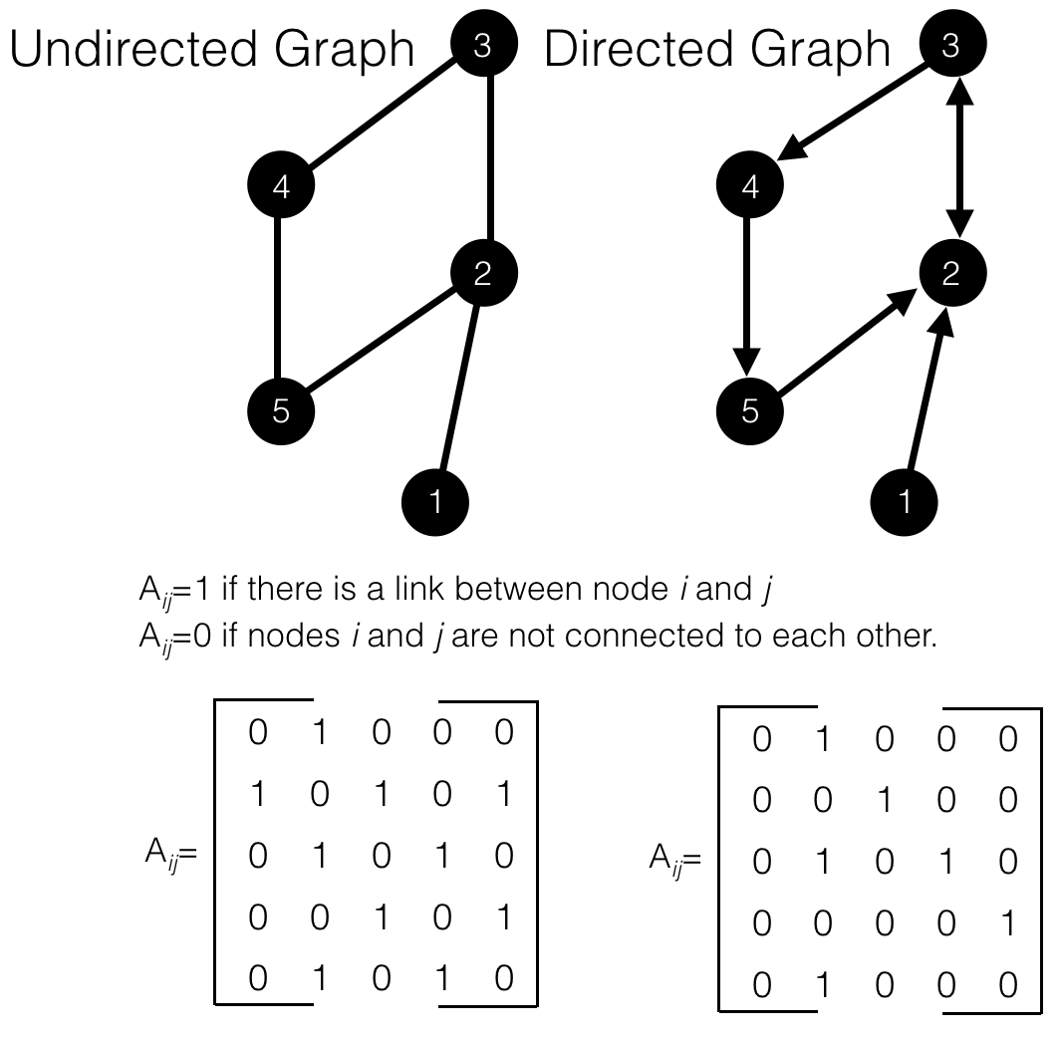
Adjacency Matrices and Node Degree
To grapple with connections we need to be able to represent the graphs mathematically. We can do this through an adjacency matrix.
Figure 8.4: Adjacency Matrix for a undirected and directed graph.

Slide 11
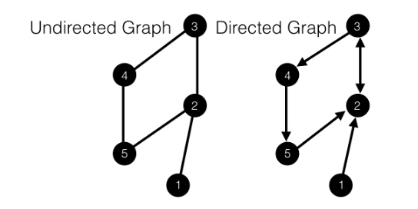
Traversing Graphs
While nodes might be directly connected, they can also be indirectly connected through a series of links.
A walk is a sequence of nodes that can be visited by following edges.
A trail is a walk with no repeated edges.
A path is a walk with no repeated edges or nodes.

Slide 12
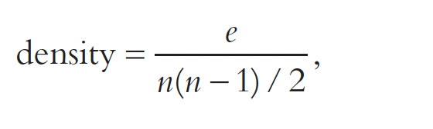
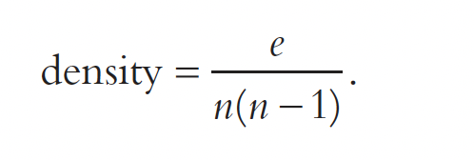
Graph Density
Another widely used concept in graph theory is density.
Density describes the overall level of linkages within the graph (ranging from 0 to 1).
A complete network would be one where all nodes are connected to all other nodes (i.e., there would be no 0s in the adjacency matrix except on the diagonal, as we assume a node is not connected to itself),
In contrast, a sparse network would be one where the nodes had very few connections.
Density therefore allows one to summarize the overall distribution of connections compared to a fully connected network.
Undirected graph
Directed graph

Slide 13
Calculating Node Importance
there are also measures that can be used to describe individual nodes within a network.
By focusing on the nodes specifically one can identify,
E.g., the most influential person in a social network or the key junction in a road network.
Various centrality measures exist , such as degree centrality, betweenness centrality, closeness centrality and eigenvector centrality
Different centrality measures give us different pictures of the network

Slide 14
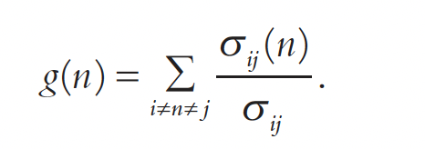
Degree centrality & Betweenness centrality
Degree centrality is equivalent to the degree of the node
In the case of a directed graph, degree centrality is often split between indegree (showing how popular the node is) and outdegree (how outgoing the node is)
Betweenness centrality is a calculation of the number of times a node acts as bridge in the shortest path between two other nodes (i.e., how central the node is).
Betweenness centrality can be calculated as follows:

Slide 15
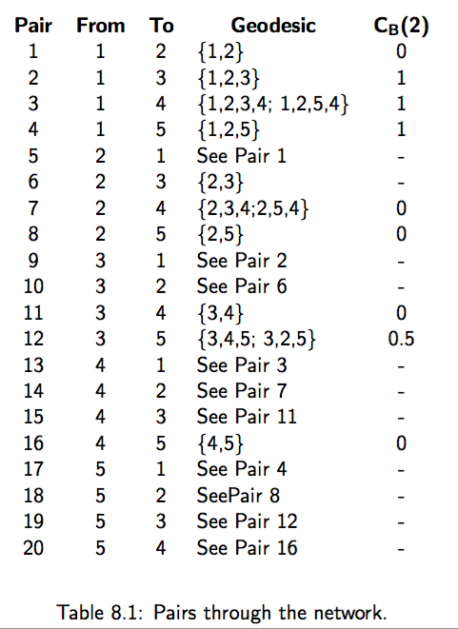
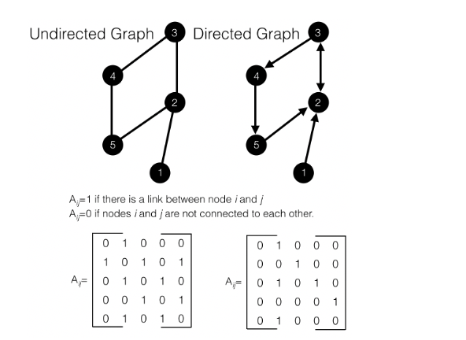
Pairs through the network
Geodesic (shortest) path between any two nodes
For an Undirected graph

Slide 16
Social Networks
Over the past decade social network analysis has grown in popularity within the social sciences
This is partly due to both increases in the amount of data available to describe social networks (e.g., through social media) and the increase in computational power available to analyze such data.
Knowing about the properties of networks, especially in the context of ‘real societies’, and representing them in agent-based models helps to understand not only how resilient they are to change, but also how information (or physical actors such as diseases etc.) can spread through them.
Notes:
Over the past decade social network analysis has grown in popularity within the
social sciences (see Borgatti et al., 2009). This is partly due to both increases in the
amount of data available to describe social networks (e.g. through social media)
and the increase in computational power available to analyse such data. Network
analysis makes it possible to explore ties such as similarities (e.g. membership in the
same clubs), social relations (e.g. kinship), interactions (e.g. talked with) and flows (e.g.
information) (see Borgatti et al., 2009). Knowing about the properties of networks,
especially in the context of ‘real societies’, and representing them in agent-based
models helps to understand not only how resilient they are to change, but also
how information (or physical actors such as diseases etc.) can spread through them.
Three well-known models for generating stylised social network structures
are: random networks (Erdo˝s and Rényi, 1960; Gilbert, 1959; Rapoport, 1957),
small-world networks (Watts and Strogatz, 1998) and scale-free networks
(Barabási and Albert, 1999).

Slide 17
Generating Stylized Network Structures
Three well-known models for generating stylized social network structures are:
Random networks (Erdoss and Rényi, 1960; Gilbert, 1959; Rapoport, 1957),
Small-world networks (Watts and Strogatz, 1998) and
Scale-free networks (Barabási and Albert, 1999).

Slide 18
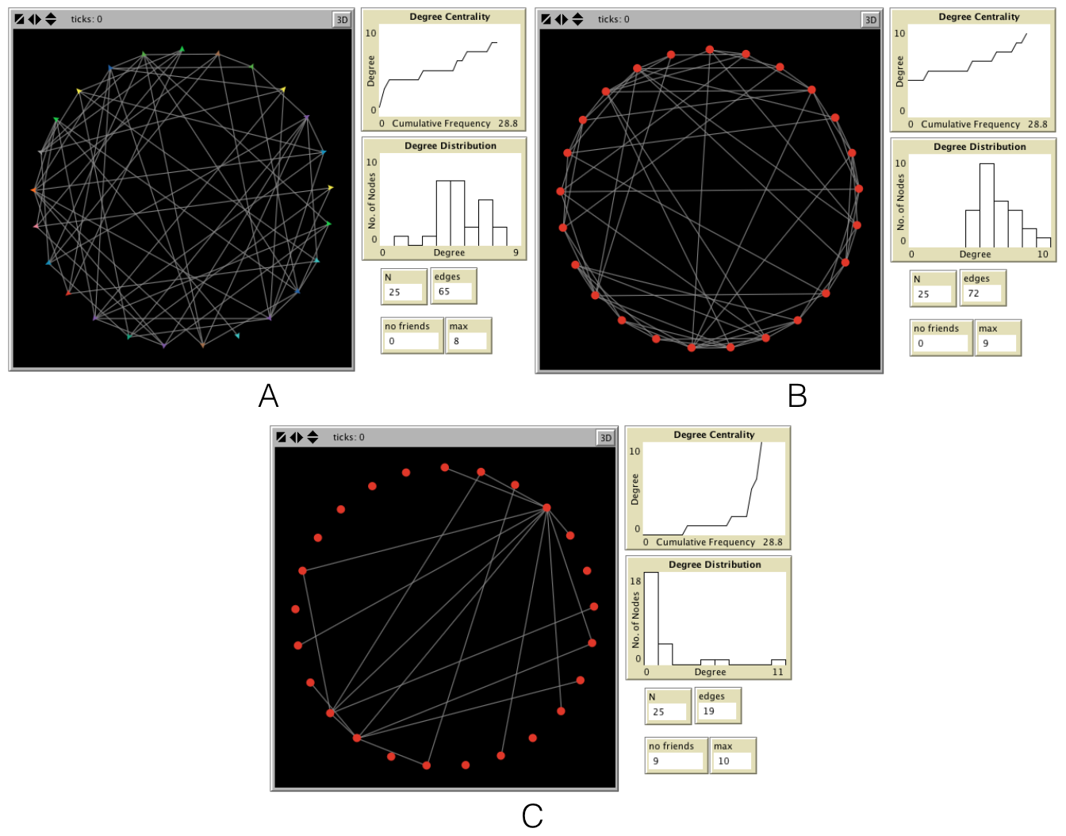
Generating Stylized Network Structures
Figure 8.5: Different network structures based in 25 nodes, 0.2 probability of a link; A: Random B: Small-World C: Scale-Free.

Slide 19
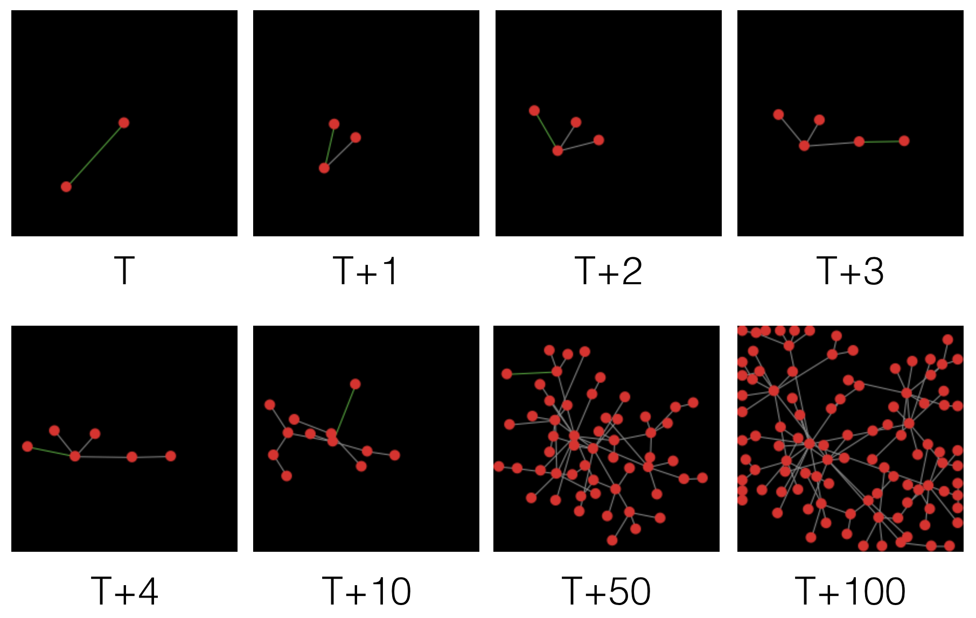
Scale Free Networks
Figure 8.6: Growth of a scale-free network via preferential attachment. (Source: Wilensky, 2005b)

Slide 20
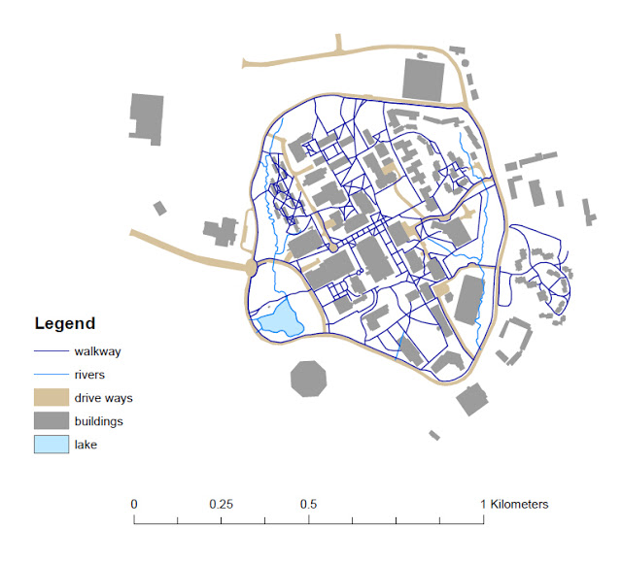
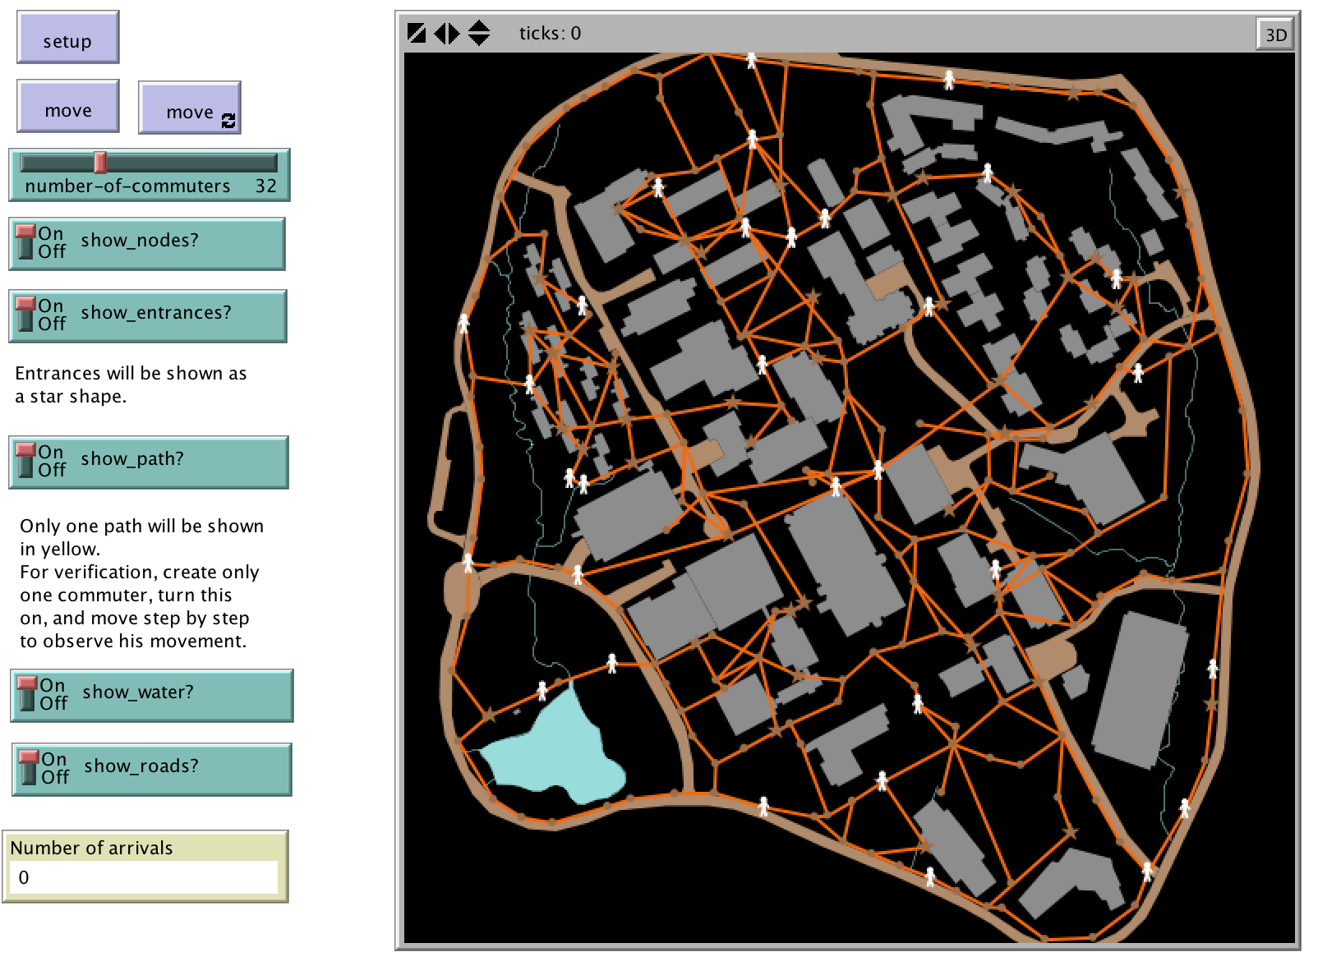
Transport Networks
Figure 8.7: Network representation within a GIS, specifically two types of networks, that of walkways and rivers.
Figure 8.8: A road network imported into NetLogo, from the GMU-Roads model.

Slide 21
Linking Geographical and Social Networks
We are currently witnessing a massive proliferation of location-aware devices such as smartphones and tablets (with in-built GPS) that allow for information to be easily contributed by users.
Such data allows us to link geographical and social Networks

Slide 22
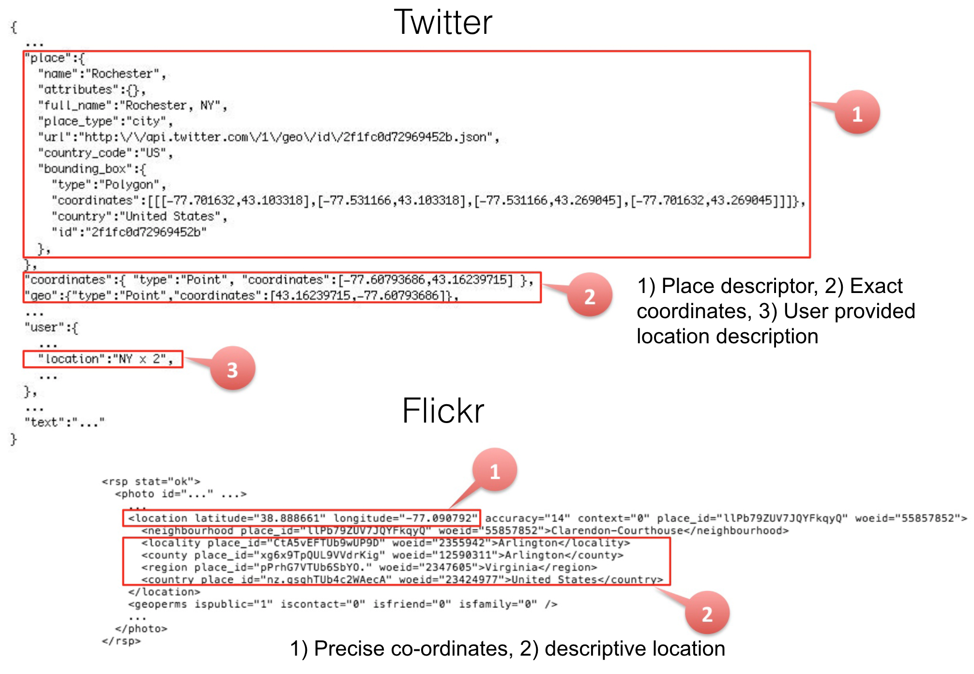
Linking Geographical and Social Networks
Figure 8.9: Metadata from Twitter tweets (top) and Flickr photos (bottom)

Slide 23
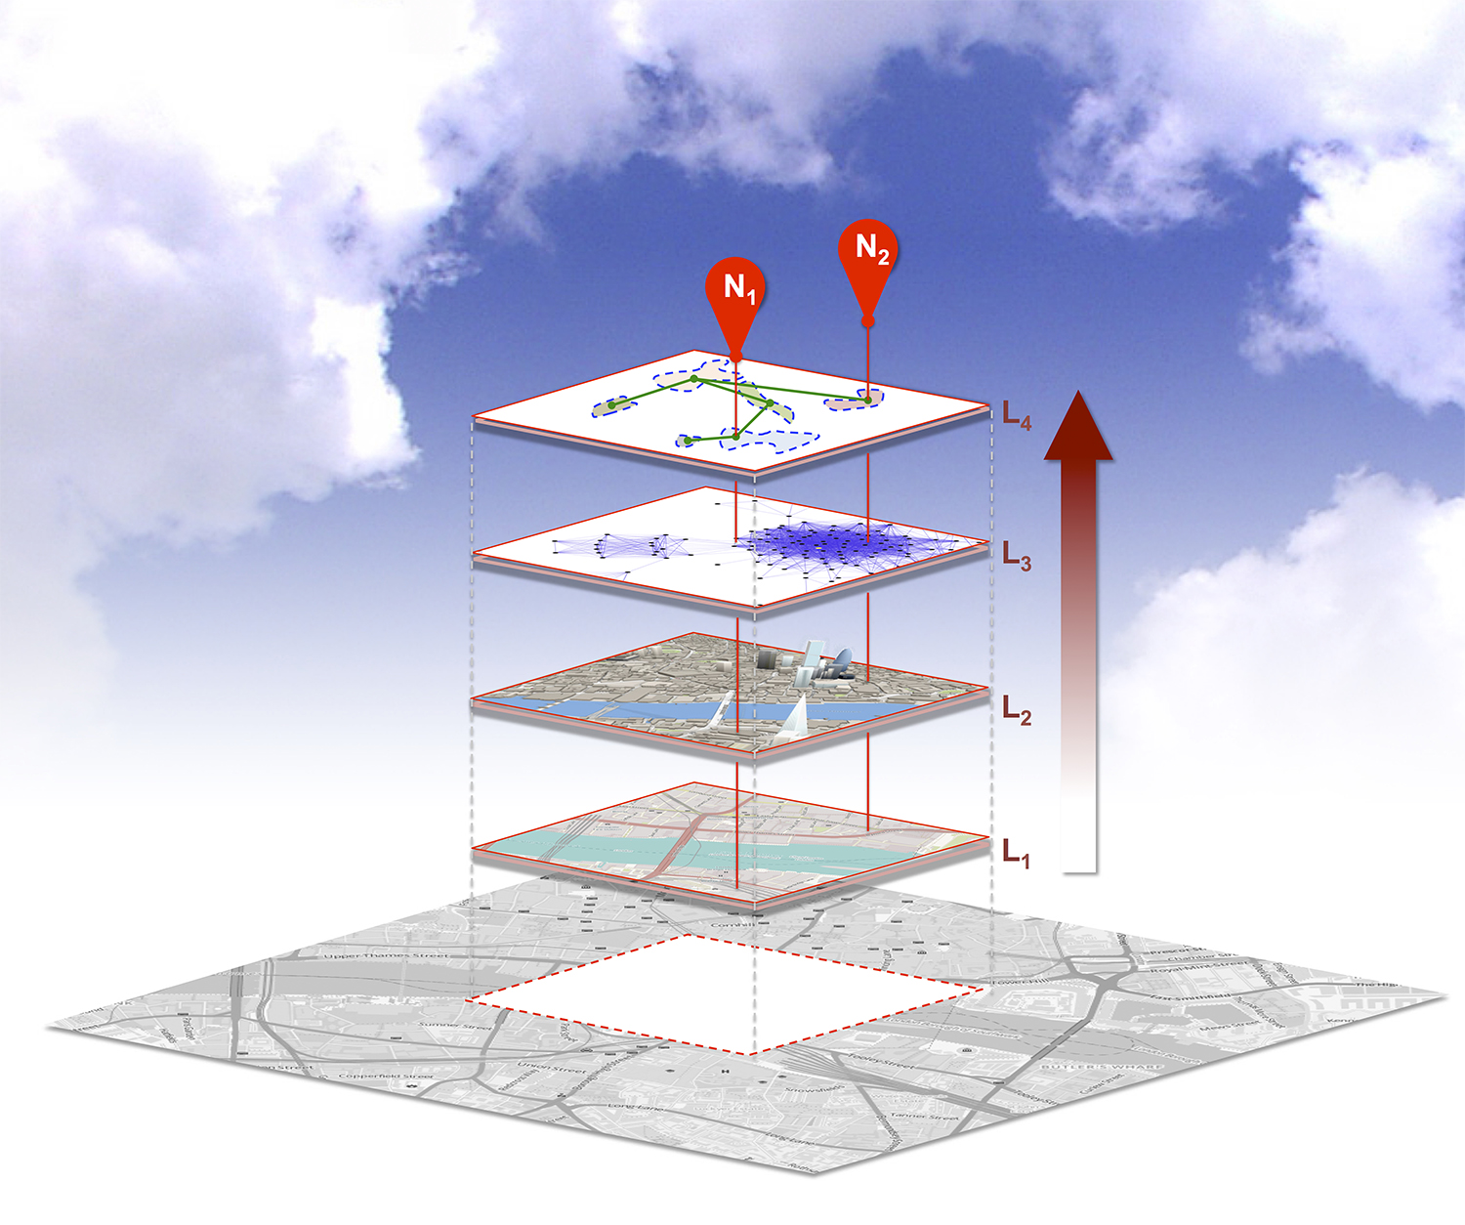
Linking Geographical and Social Networks
Figure 8.10: Schematic diagram illustrating how different networks can be linked together. From physical (L1, L2), and social (L3) spaces to derive place abstractions (L4) for different locations (N1, N2). (Source: Crooks et al., 2016)

Slide 24
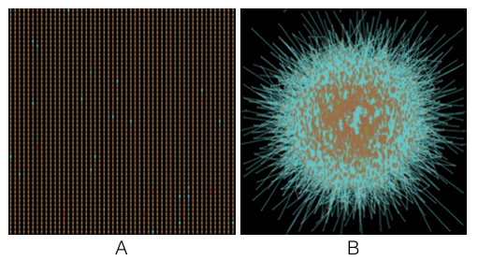
Linking Geographical and Social Networks
Figure 8.11: Agents and Networks: A: The Physical environment and B: the agents social (cyber) networks.

Slide 25
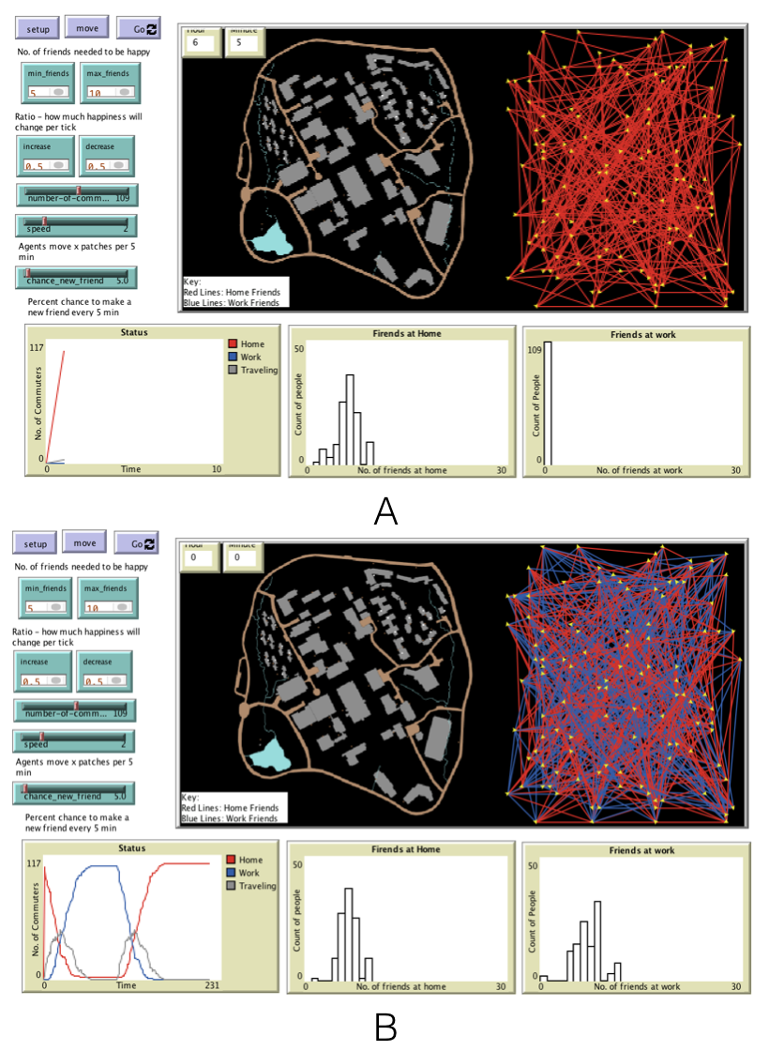
Agents and Networks
Figure 8.12: Agents and Networks related to going to and from work A: Initial social network based home locations while B: shows how the social network evolves over time as agents interact with each other.

Slide 26
Summary
The complex realities of the world around us can be abstracted into a graph.
Graphs can be analyzed to shed light onto the the importance of a node.
e.g., a person or a intersection in a road.
There are various types of networks:
E.g., random, scale free
The symbiosis of network analysis and ABM is to be able to capture how network structures can influence how individual agents behave or move through geographical systems.
New forms of data (e.g.. social media, mobile phone calls) is shedding light on peoples connections and provide new opportunities to study geographical systems.

Slide 27
Further Reading
For a comprehensive overview of social network analysis, methods and applications, readers are referred to:
Wasserman & Faust (1994) Social Network Analysis: Methods and Applications. New York: Cambridge University Press.
For a classic work work on the role of networks within geographical systems, readers are referred to:
Haggett & Chorley (1969) Network Analysis in Geography. London: Edward Arnold.
For more details on how to instantiate networks and use them within agent-based models created using NetLogo, readers are referred to:
Wilensky & Rand (2015) An Introduction to Agent-Based Modeling: Modeling Natural, Social, and Engineered Complex Systems with NetLogo. Cambridge, MA: MIT Press.
In NetLogo complex topological networks (e.g., roads) will make make the model slow to run. Therefore, its sometimes good to simplify the network consider using the online tools such as Mapshaper: http://mapshaper.org

Slide 28
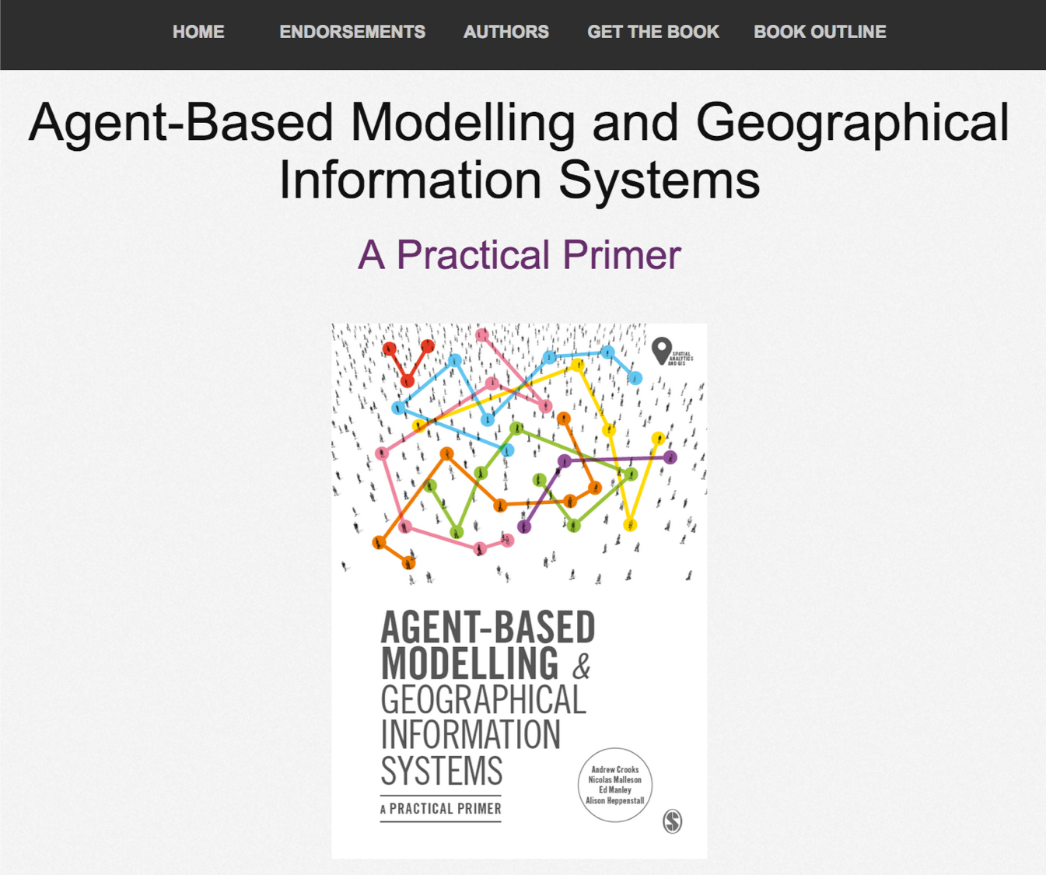
Online Resources
Visit: https://github.com/abmgis/abmgis/tree/master/Chapter08-Networks for a selection of models to highlight core concepts introduced in this chapter.

